Slide 1
BIOBIN - DIRECT SELLING
GUIDED BY:
Dr. L. THARA,
Department of Computer Science,
PSG College of Arts & Science.
SUBMITTED BY:
AKILESH S
19BCM002
akilesh04.ss@gmail.com

Slide 2
Overview
The project “THE BIOBIN - DIRECT SELLING” is developed under the platform of windows 10, React Js, Node Js as front end, Express Js as backend, MongoDb as database and Node Js as web server.
The project is developed in the motive of promoting the organic farming and waste recycling.
In Today’s world, we could see tremendous change in the lifestyles. Due to the change, the mode and method of farming has evolved a lot. Albeit there is an improvement in the techniques but the products produced nowadays are not much healthier than which are produced by traditional method. It's all because of artificial fertilizers and pesticides.

Slide 3
The company “FARMHAAT” , accepts all the bio waste that are produced from the houses, farms, hotels and others when the request is initiated from the client side. The wastes will be collected and the client will be paid with respect to the weight of the waste.
The company follows the concept called “DIRECT SELLING”. In which they sell their products directly to the consumers. Initially, they sell through their showrooms and now through the project company can sell it through online also.
It helps the product easily available to the consumers.

Slide 4
EXISTING SYSTEM OVER PROPOSED SYSTEM
Mediators or supply agents are made use to sell.
Online transactions are not fully utilized for making payments.
Products are not easily available for the customer.
Waste collection is not maintained and arranged properly.
Website avoids the agents to sell.
Only online transactions are used to make payments.
Products are easily available and can buy wherever they want it.
The system is maintained and managed properly.

Slide 5
SYSTEM CONFIGURATION
HARDWARE SPECIFICATION
Processor: Intel(R) Core(TM) i3-5015U
CPU @ 2.10GHz 2.10 GHz
RAM: 4.00 GB
OS: Windows 10 Pro
SOFTWARE CONFIGURATION
Front-End: ReactJs & NodeJs
Backend: ExpressJs
Database: MongoDB
Web server: NodeJs

Slide 6

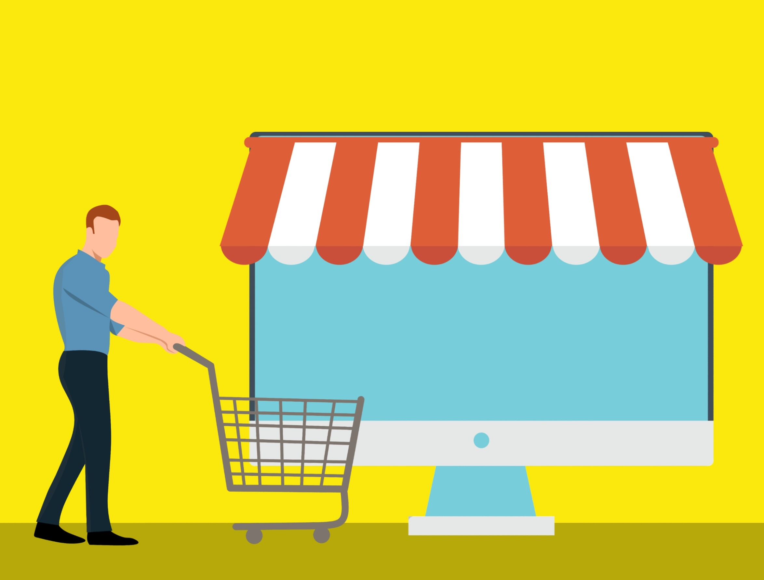
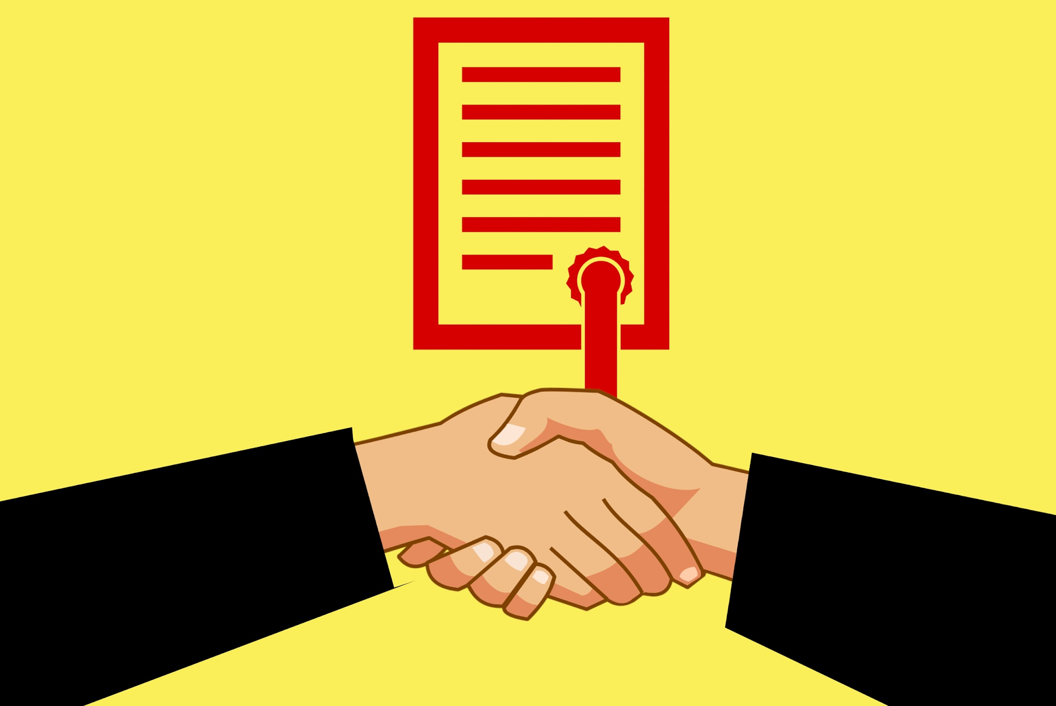
Modules
USER PRODUCT INVESTOR

Slide 7
USER MODULE
This module will maintain the user records and this module helps in creating a record and validating the records.
The module is subdivided into two sub modules are:
Register
Login

Slide 8
REGISTER MODULE
This module helps in creating new records of the users. The details like Name, Email, Address, Phone and password to register a new user. The system asks the customer to type the passwords for two times to assure that the entered password is correct. The customer will be made alert through mail when a new user is registered.

Slide 9
Login Module
This module can be further divided into two sub modules.
Admin
Customer
Admin:
This module maintains all the records of the orders , pick-ups and the other databases. The admin pages and the records can be viewed only by the admin.
Customer :
The customer can register and login to the website. To explore it and buy!

Slide 10
PRODUCT MODULE
This module is one of the important module where the sales of the products take place. This module maintains the all records of the available products. This module is further divided into three modules.
Cart
Payment
Orders
These three modules play a vital role in placing an order by the customer.

Slide 11
Cart:
This modules stores and displays the items that are added to the cart by the user. The user can add a new item or delete a new item from the already added items. Once the payment is successful the items will be moved to the orders module.
Payment:
This module make the user to pay the respective price through online transactions like Gpay or Cards.
Orders:
This module stores all the items that are previously ordered by the user. The user can also give the feedback of the product.

Slide 12
INVESTOR MODULE
This module is maintains the records of the users those apply for the pick-ups. The user can initiate the request by filling out the given form in the website. Once the user initiated the request, User will be made alert through a mail and the updates will be sent through mail.

Slide 13
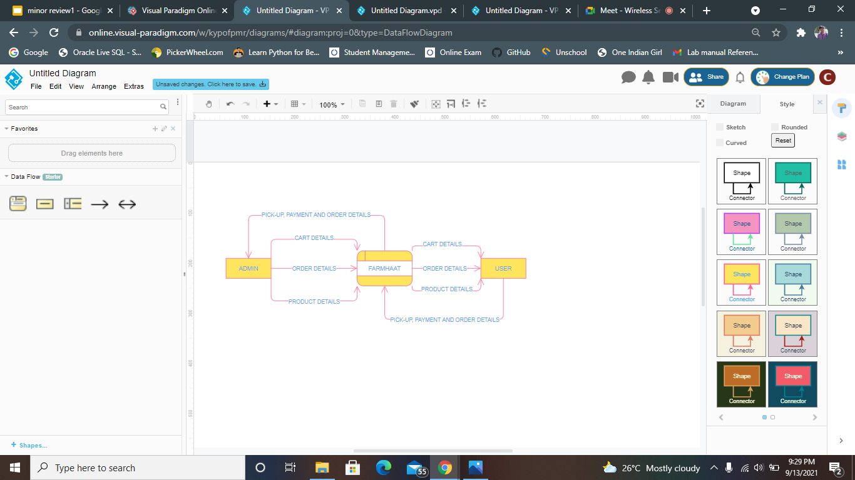
DFD LEVEL-0

Slide 14
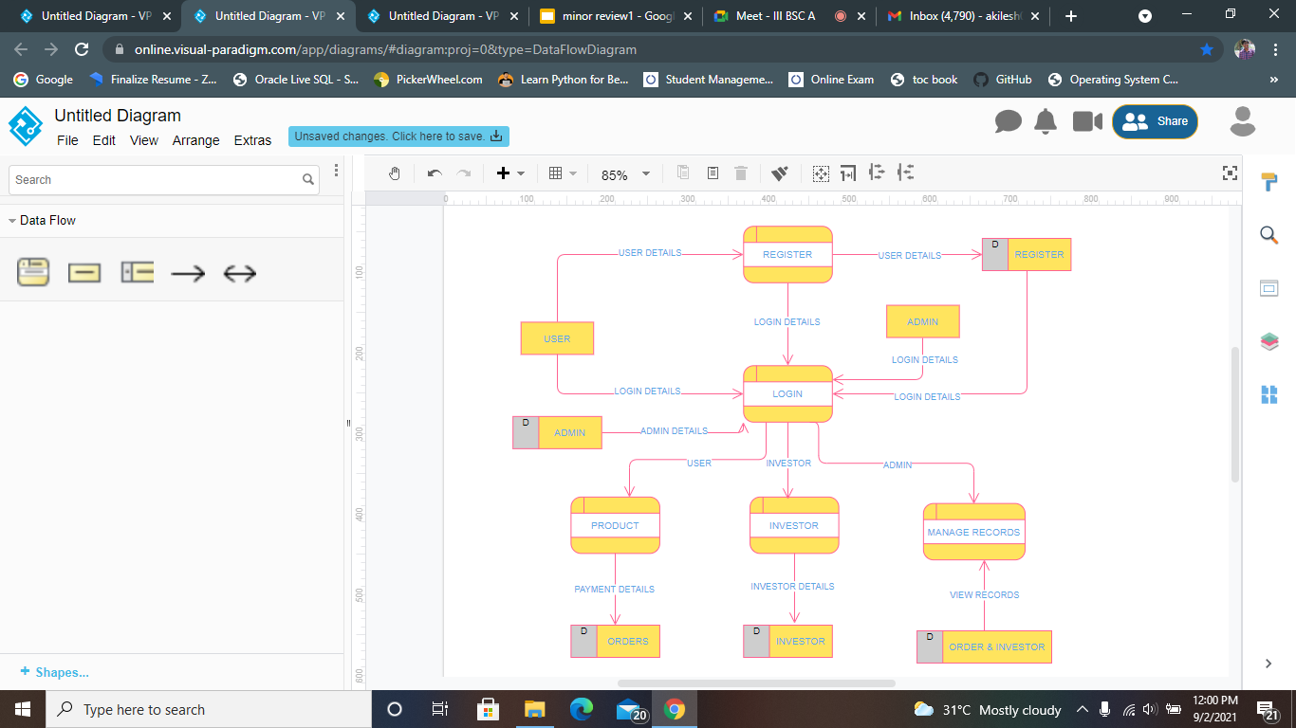
DFD LEVEL-1

Slide 15
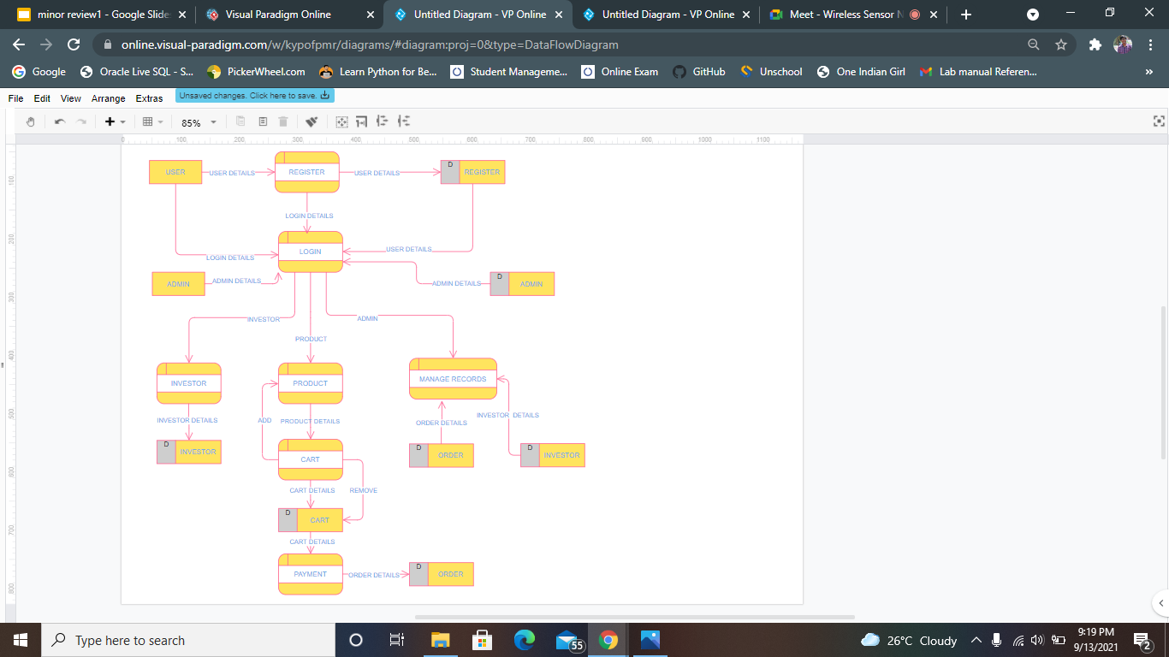
DFD LEVEL-2

Slide 16
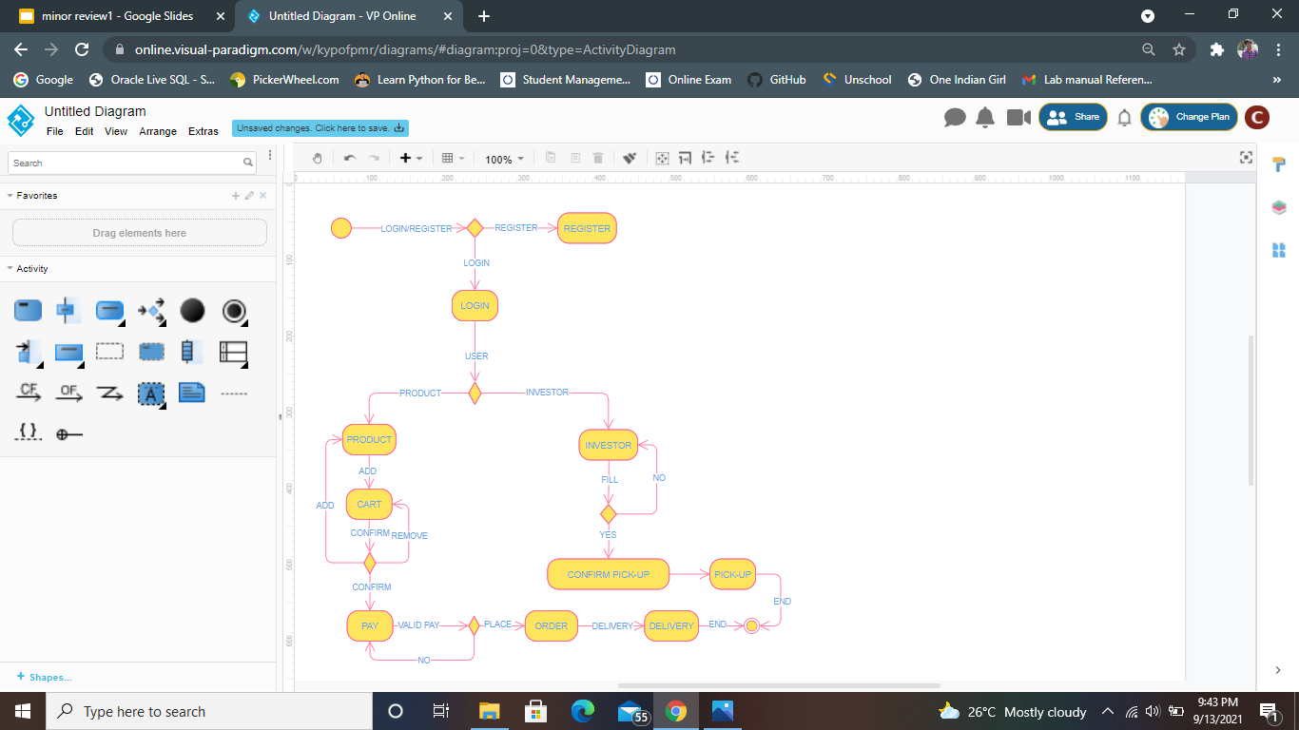
ACTIVITY DIAGRAM

Slide 17
THANK YOU

